Slide 1


Game Engine
FYP 1 Presentation
Instructor: Samyan Wahla
Presentation by: Hamza Farooq (2016CS122)

Slide 2


What is a game engine ?
Run Time Engine Architecture
Tools and the asset pipeline
Types of Engines
Tools of the trade
Best rated engines

Slide 3
A game engine is a software framework designed for the creation and development of video
games. Developers use them to create games
for consoles, mobile devices and personal computers.
Set of tools to assist in making a game
Game agnostic software components
Reusable for many different games
Multi-platform (typically)
Allows for data driven development
Makes development faster!

Slide 4
Target Hardware
Device Drivers
Operating System
Third-Party SDKs and Middleware
Platform Independence Layer
Core Systems
Resource Manager
Rendering Engine
Profiling and Debugging Tools
Collision and Physics
Animation
Human Interface Devices (HID)
Audio
Gameplay Foundation Systems

Slide 5









Renderer (2D or 3D)
Collision Detection
Scripting
Sound/Video
Animation
Shading/Lighting
Networking
Physics
Artificial Intelligence
Level Editor
Custom Tools

Slide 6
Digital Content Creation Tools
A game engine’s input data comes in a wide variety of forms, from 3D mesh data to texture bitmaps to animation data to audio files. The tools that the artists use are called digital content creation (DCC) applications.

Slide 7


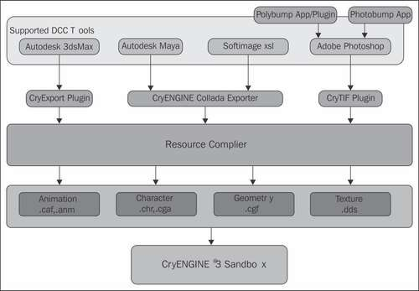

Slide 8


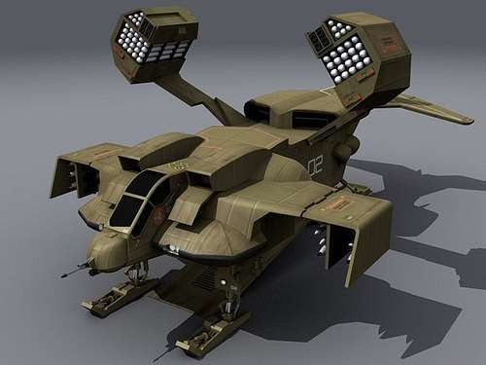
Used by the Render Engine, Sound/Video Engine, Animation Engine
Anything that is in the game besides code
Models
Textures
Sounds
Videos
Animations

Slide 9


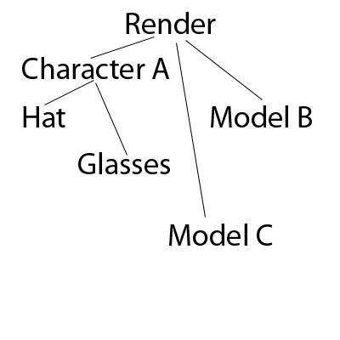

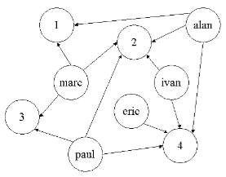
Tells the Render Engine where to place Assets
Arranges a scene
Logically
Spatially
Tree Structure
Hierarchical
Graph Structure
Non-hierarchical

Slide 10


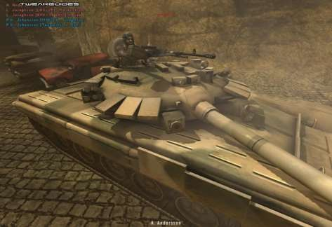
Usually built onOpenGL or DirectX
Generates images in
real-time from assets
Controlled by the Scene Graph
Interacts directly with the
GPU

Slide 11
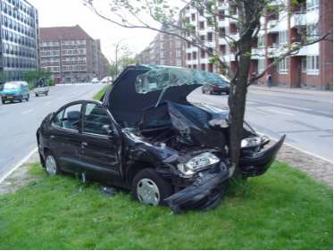
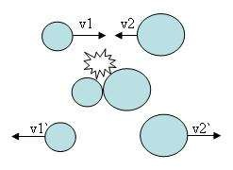
Intersection of two given solids
Spheres
Planes
Tubes
Polygons
Collision Response
Event

Slide 12



Usually uses an interpreted language (Python, etc.)
Allows custom code
Does not require the source code
Does not change any engine code
Game Specific

Slide 13


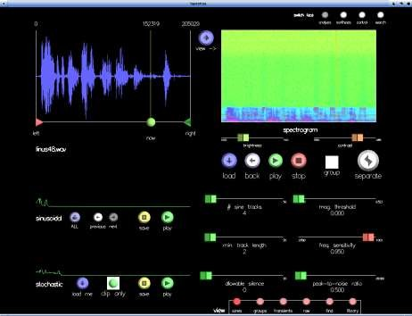
Usually played based on an event
Built off of an external library
(OpenAL,etc.)
Video is often only for cut- scenes or as part of in-game objects
Sound is for music and sound effects
Handles sound objects that
can control surround sound and 3D sound

Slide 14


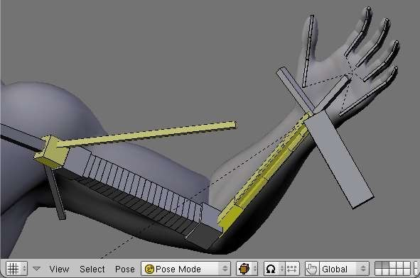
Handles animation of objects on the Scene Graph
Tween animation
Rig/Skeleton Based animation
Tells the Renderer how to display the assets

Slide 15
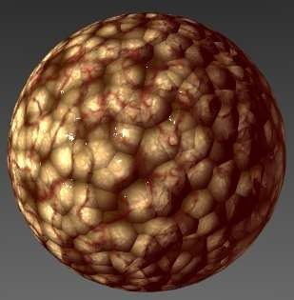
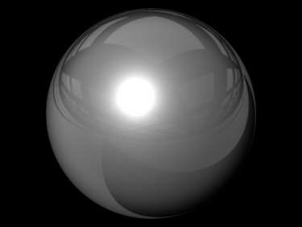
Calculates special effects
Shadows
Normal Maps
Particle Effects
More...
Applied by the Render Engine on objects in the Scene Graph

Slide 16



Handles multicomputer communication
Peer to Peer
Client to Server
Distributed

Slide 17


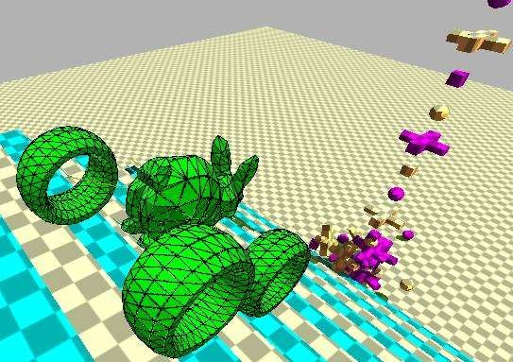
Handles behavior of objects based on collisions
Simulates or predicts physics models
Rigid Body Dynamics
Soft Body Physics
Fluid Dynamics

Slide 18

Controls object interaction
Stimuli
Needs
Desires
Flocking
Often uses Finite State Machines

Slide 19


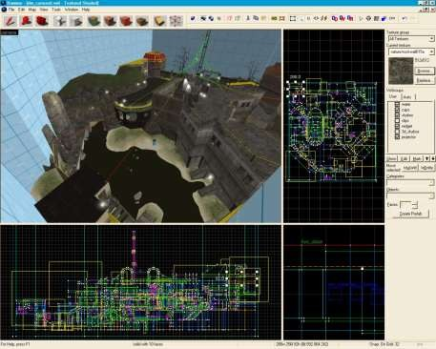
Allows placement of multiple assets to create environments
Can allow custom scripting for AI
Primarily used for static asset placement

Slide 20
Microsoft Visual Studio
Profiling Tools : It can tell you how much time is spent in each function.
Memory Leak and Corruption Detection

Slide 21

Unreal Engine 4:
The Unreal Engine is a game engine developed by Epic
Games, first showcased in the1998 first person shooter game Unreal.
With its code written in C++, the Unreal Engine features a high degree of portability and is a tool used by many game developers today.
Company: Epic games
Platforms (UE4): consoles, TBA, PS3.
Used in (UE3): Gears of War, Infinity Blade, Mass effect etc.

Slide 22


Unity is a cross-platform game engine developed by Unity Technologies and used to develop video
games for PC, consoles, mobile emphasis on portability, the
devices and With an
engine targets the following
APIs: Direct3D on Windows and Xbox 360; OpenGL on Mac and Windows; OpenGL ES on Android and iOS; and proprietary APIs on video game consoles.
Platforms: Android browser, flash, iOS, Linux, Mac, PC, PS3,
Wii U, Xbox 360.
Used in (Any Version): Bad Piggies, Castle Stories, Dead Trigger 2, Wasteland 2.

Slide 23



CryEngine is a game engine designed by
the German game developer Crytek. It has been used in all of their titles with the initial version being used in Far Cry,
It has also been used for many third-party games under Crytek's licensing scheme, including Sniper: Ghost Warrior 2 and SNOW.

Slide 24



AppGameKit was developed out of our own need to create a one stop solution for making game apps for mobile devices.
It enables you to write codes for multiple platforms, including Android iOS, Windows, Mac, and Linux.
AGK script has powerful commands for networking, 2D graphics, and physics.

Slide 25
Thank You

Slide 26
Any Questions?

